Slide 1

INTRODUCTION OF MICROPROCESSOR
MBEYA UNIVERSITY OF SCIENCE AN TECHNOLOGY
OCTOBER 2022
LECT 1
E. MWANGOSI

Slide 2
OUTLINE
Block diagram of a computer system
  Basic components of a computer system using block diagrams:
    Cpu
    Memory
    Input and output unit
Evolution of microprocessor : 4,8,16,32 and 64 byte
Fecthing and execution cycles.
Nibble, byte, word dan longword
Internal structure and basic operation of a microprocessor (arithmetic and logic unit, control unit, register sets, accumulator, condition code register, program counter, stack pointer)
Bus system: data bus, address bus and control bus.
Microprocessor clock system
Examples of microprocessor: 8085,8086.

Slide 3
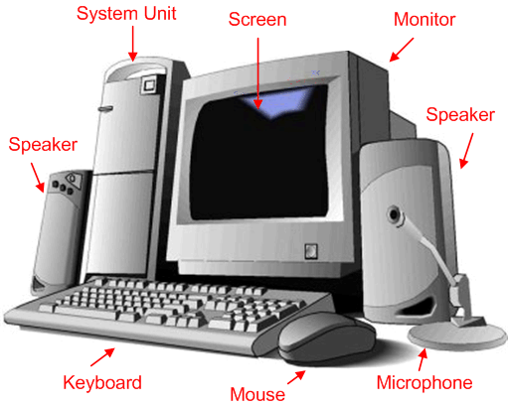
DIAGRAM OF A COMPUTER SYSTEM
A computer is a programmable machine that receives input, stores and manipulates data//information, and provides output in a useful format.
Diagram Of A Computer System

Slide 4
BLOCK DIAGRAM OF A BASIC COMPUTER SYSTEM
Basic computer system consist of a Central processing unit (CPU), memory (RAM and ROM), input/output (I/O) unit.
Address bus
CPU
ROM
RAM
I/O
interface
I/O
devices
Data bus
Control bus
Block diagram of a basic computer system

Slide 5
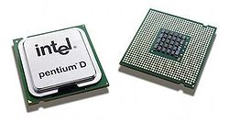
Basic component of micro-computer
CPU - Central Processing Unit
  the portion of a computer system that carries out the instructions of a computer program
  the primary element carrying out the computer's functions. It is the unit that reads and executes program instructions.
  The data in instruction tells the processor what to do.
Pentium D dual core processors

Slide 6
2. Memory
  physical devices used to store data or programs.
  Computer main memory comes in two principal varieties: random-access memory (RAM) and read-only memory (ROM).
  RAM can be read and written at anytime the CPU commands it, but ROM is pre-loaded with data and software that never changes, so the CPU can only read from it.
  ROM is typically used to store the computer's initial start-up instructions.
  In a PC, the ROM contains a specialized program called the BIOS that orchestrates loading the computer's operating system from the hard disk drive into RAM whenever the computer is turned on or reset.
  In general, the contents of RAM are erased when the power to the computer is turned off, but ROM retains its data indefinitely.

Slide 7
3. I/O Unit
  Input/output (I/O), refers to the communication between an information processing system (such as a computer), and the outside world possibly a human, or another information processing system.
  Inputs are the signals or data received by the system, and outputs are the signals or data sent from it.
  Devices that provide input or output to the computer are called peripheral
  On a typical personal computer, peripherals include input devices like the keyboard and mouse, and output devices such as the display and printer. Hard disk drives, floppy disk drives and optical disc drives serve as both input and output devices. Computer networking is another form of I/O.

Slide 8
Evolution of microprocessor
Generally characterized by the “word” size (registers and data bus)
  8-bit, 16-bit, 32-bit, 64-bit
  addressable memory related to the word size
  Early Intel Processors
  Intel 8080 (1974)
    8-bit, first truly usable μ−processor (40 DIP)
    seven 8-bit registers (six of which can be combined as three 16-bit registers)
    6K transistors, 2MHz clock
    Other notable 8-bit processors include Zilog Z80 (1976) (used in Osborne 1, first portable μ-computer) and Motorola 6800/6809 (1978)
    Small cost, compact packaging allowed home computer revolution
  Intel 8080 later variants
    64K addressable RAM (16-bit bus address)
    8-bit registers
    CP/M (control program for μ−computers) OS
    5,6,8,10 MHz
    29K transistors
  Intel 8086/8088 (1978)
    16-bit processor, IBM-PC used 8088
    1 MB addressable RAM (20-bit addresses)
    16-bit registers
    16-bit data bus (8-bit for 8088)
    separate floating-point unit (8087)
    used in low-cost microcontrollers now

Slide 9
Other 16-bit processors
Western Design Center (WDC 65816)
  used in Apple II and Super Nintendo
  fully CMOS, low power consumption (300 μA at 1MHz, operating voltage as low as 1.8V)
  Wait-for-Interrupt and Stop-the-Clock instructions further reduce power consumption
  one of the most popular (made in huge numbers)
  Still sold today (original 1984), used as a controller
  24-bit address bus (16MB of memory space)
Texas Instrument TM9900, National Semiconductor IMP-16, etc.
Intel 80286 (1982) IBM-AT
  Still largely a 16-bit processor
  16 MB addressable RAM
  Protected memory
  several times faster than 8086
  introduced IDE bus architecture
  80287 floating point unit
  Up to 20MHz
  134K transistors

Slide 10
32-bit processors
Motorola 680x0 series
  32-bit registers
  68010 (1982) adds virtual memory support
  Other successors 68020/68030/68040/68060
  Popular with UNIX operating systems in late 1980’s/early 1990’s
  Faded from computer desktop market, but had a strong standing in embedded / controller equipment (still used)
“Microprocessor wars”
  leads to elimination of some / survival of the fittest. In aftermath, the PC market to be largely dominated by IA-32; however, much more diversity exists for the controllers
    Intel386 (1985) IA-32
      4 GB addressable RAM
      32-bit registers
      paging (virtual memory)
      Up to 33MHz
    Intel486 (1989)
      instruction pipelining
      Integrated FPU
      8K cache
    Pentium (1993)
      Superscalar (two parallel pipelines)
      Intel declines to license Pentium to others, AMD and Cyrix start their own designs

Slide 11
Intel Pentium Family
Pentium Pro (1995)
  advanced optimization techniques in μ-code
  More pipeline stages
  On-board L2 cache
Pentium II (1997)
  MMX (multimedia) instruction set
  Up to 450MHz
Pentium III (1999)
  SIMD (streaming extensions) instructions (SSE)
  Up to 1+GHz
Pentium 4 (2000)
  NetBurst micro-architecture, tuned for multimedia
  3.8+GHz
Pentium D (Dual core)
…

Slide 12
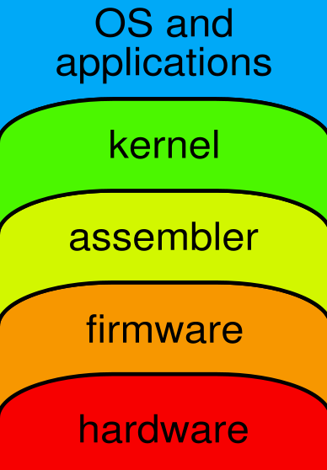
Programming
Interpreted High Level Language
Compiled High Level Language
Assembly Language
Machine Language

Slide 13
Programming (2)
Machine Language
  binary instructions (op codes) actually read and interpreted by the CPU
  Ex: 1000 1011 0000 0101
  ‘move value from memory to AX register’ on intel386
  different for each CPU type
Assembly Language
  CPU instructions represented by mnemonics
  Ex: MOV AX, M same as above
  each AL instruction converts to one ML instruction by assembler program
  Efficient fast execution, inconvenient to program in
  Allows access to instructions not available with higher level language

Slide 14
Programming (3)
High Level Language, e.g. C/C++
  easier to use
  it’s compiler’s job to translates (one) HLL instruction into (many) ML instructions
  portable: can compile the same source (HLL instructions) on different OS platforms
  slower and more restricted
Interpreted Languages, e.g. JAVA, scripting
  on-the-fly translation of high level language
  slowest of the above, but often a good place to start with a new project

